Slide 1

Bank Card Transaction Analysis
Presented by Mohammad Zahra
28.08.2026

Slide 2
Project Scope & Constraints
In Scope
Customers and bank accounts
Payment cards
Card payment transactions
Merchants and merchant categories
Transaction locations and time periods
Out of Scope
Loans and mortgages
Bank transfers and investments
Cash withdrawals
Fraud detection and credit risk
Online banking / other banking products
1

Slide 3
Key Business Rules
Each card has one cardholder and is linked to one account
Each transaction uses one card and is made at one merchant
Each merchant belongs to one merchant category
One customer/account/card can participate in many transactions
Each Merchant represents one individual merchant location; merchant chains or brands are not modeled separately.
2

Slide 4

Business Database & Source Data
3

Slide 5
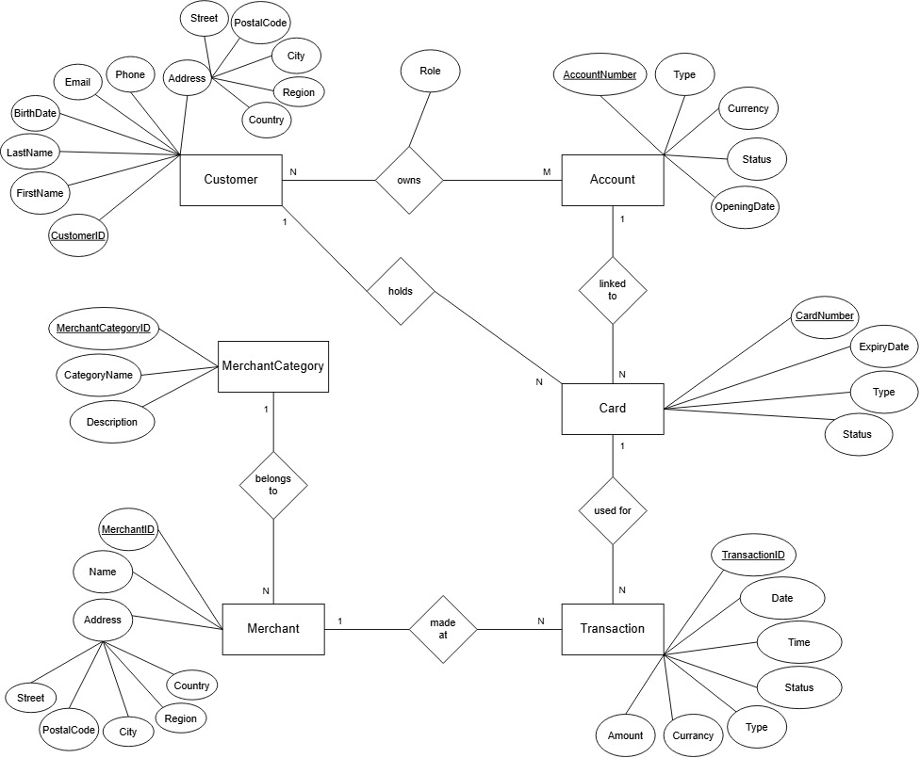
Business Database – ER Model
4

Slide 6
Quote
Source Data
AI-generated banking dataset (GPT-5.6 Sol)
119 customers, 179 cards, 40 merchants, 12 merchant categories
Around 2,000 card transactions
Period: 2024–2026
Currencies: EUR, USD, GBP, CHF
5

Slide 7
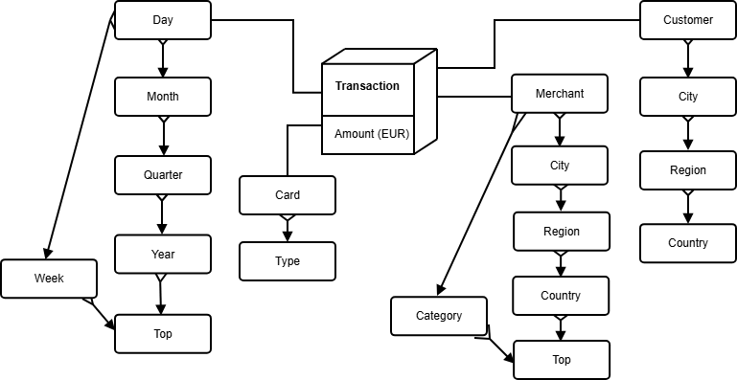
Multidimensional ER Model
6

Slide 8
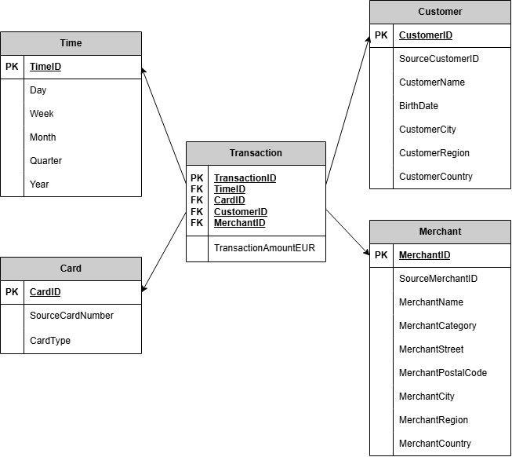
Logical Star Schema
7

Slide 9
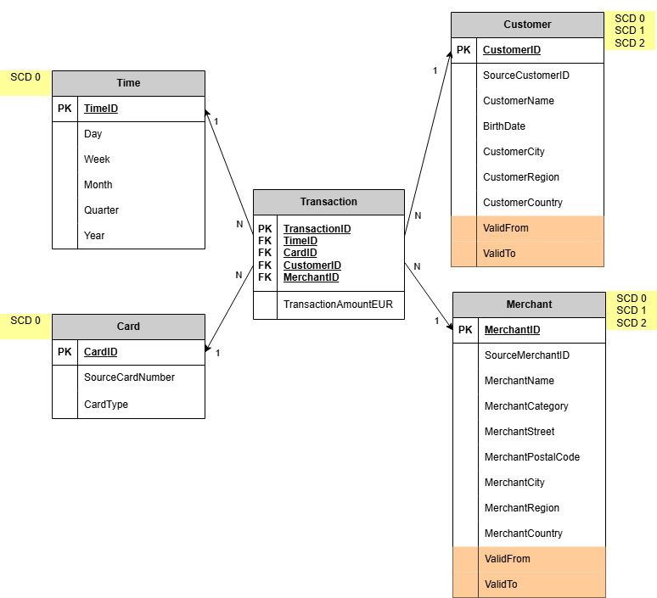
Slowly Changing Dimensions (SCD)
Time & Card: SCD Type 0
Customer & Merchant: combination of SCD 0 / 1 / 2
Type 2 history: ValidFrom / ValidTo
8

Slide 10
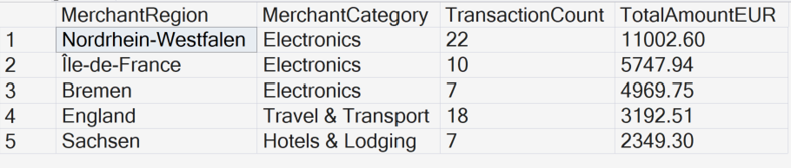
Top merchant category per region in 2026
9

Slide 11
ETL Process & Scheduling
ETL implemented with Stored Procedures
Incremental Fact Load using control table / Last_loading_Date
Currency conversion to EUR during transformation
ETL validation: row counts, duplicates, foreign keys, future dates
Planned schedule: daily batch; manual execution in project
10

Slide 12
Takeaways & Lessons Learned
Highlights
Complete pipeline from relational Business DB to analytical Star Schema
ETL with Stored Procedures, mapping and validation successfully implemented
Problems & Solutions
Multi-currency transactions → converted to EUR during ETL
No source change timestamps → initial SCD records use ValidFrom = 1900-01-01
Key Takeaway
Source data completeness determines what can be reliably analyzed and modeled in the DWH
Business rules and analytical requirements should be clear before modelling
11

Slide 13

Thank you
Presented by Mohammad Zahra
28.08.2026

